Slide 1

DemonstrateGator Character
We are Respectful, We are Responsible, We are Safe,
in the Media Center…

Slide 2
I can be a Gator Character.
I can be Respectful, Responsible, and Safe in the media center.

Slide 3
Guided Discovery: Could someone tell us what we are going to learn and practice today?
WE ARE RESPECTFUL | WE ARE RESPONSIBLE | WE ARE SAFE
Enter, move, & speak quietly Use good manners Listen actively and avoid disrupting lessons Practice patience- wait for your turn Speak with appropriate language | Follow circulation procedures Use shelf markers correctly Return books and checkout every week Clean up, push in chairs, throw away mess and trash Drop or return books into the book drop slot | Walk at all times Keep hands and feet off the cords and wires Pick up fallen books Stay in your Seat Keep the legs of your chair on the floor Go to approved websites
____________________________ ________________________________________________________________
____________________________________________________________________________________________
____________________________________________________________________________________________
____________________________________________________________________________________________

Slide 4
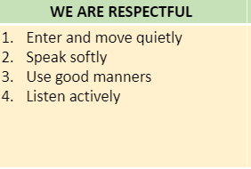
How are Gators Respectful in the Media Center?

Slide 5
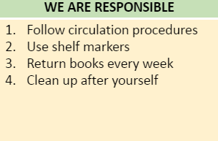
How are Gators Responsible In the Media Center?

Slide 6
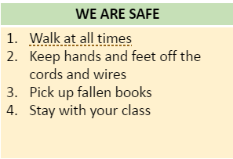
How are Gators Safe in the Media Center?

Slide 7
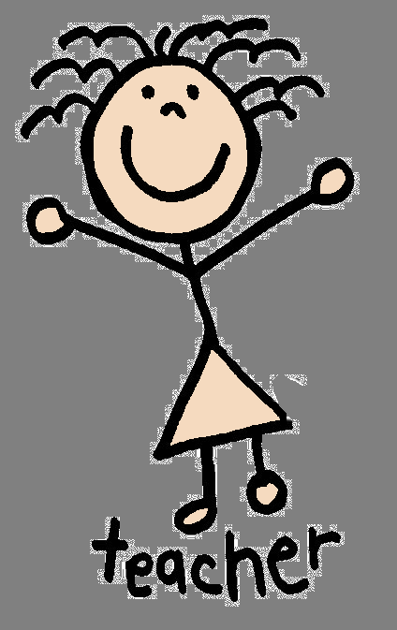
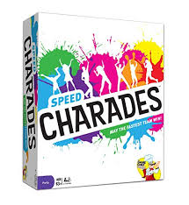
Describe DEMONSTRATING GATOR CHARACTER in the media center: ____________________________________________________________________________________________
____________________________________________________________________________________________
____________________________________________________________________________________________
____________________________________________________________________________________________
Demonstrating
Demonstrate examples of NOT following expectations
NOT A RESPECTFUL GATOR
NOT A RESPONSIBLE GATOR
NOT A SAFE GATOR
This Photo by Unknown author is licensed under CC BY-NC.

Slide 8
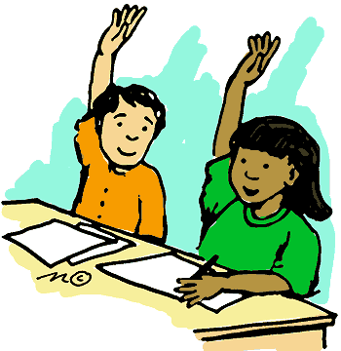
Choose a couple of students to show how to be a Gator Character in the LMC.
MODELING
Model examples of NOT following expectations
A RESPECTFUL GATOR
A RESPONSIBLE GATOR
A SAFE GATOR
This Photo by Unknown author is licensed under CC BY-NC.

Slide 9


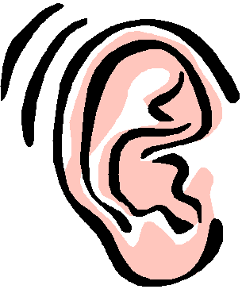
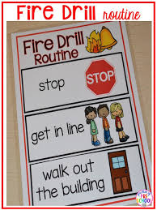
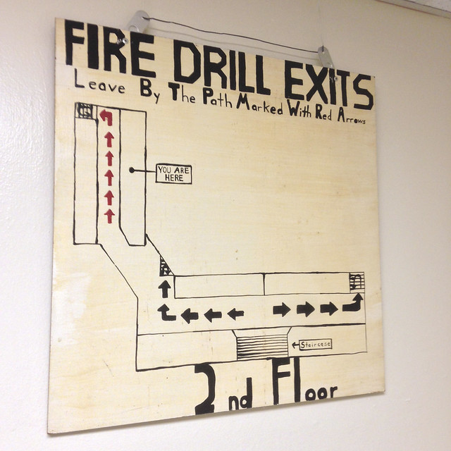
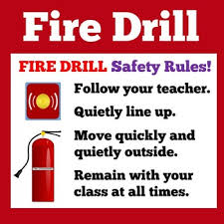

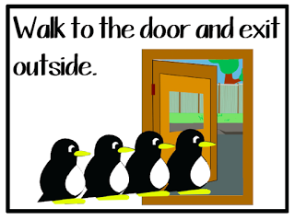

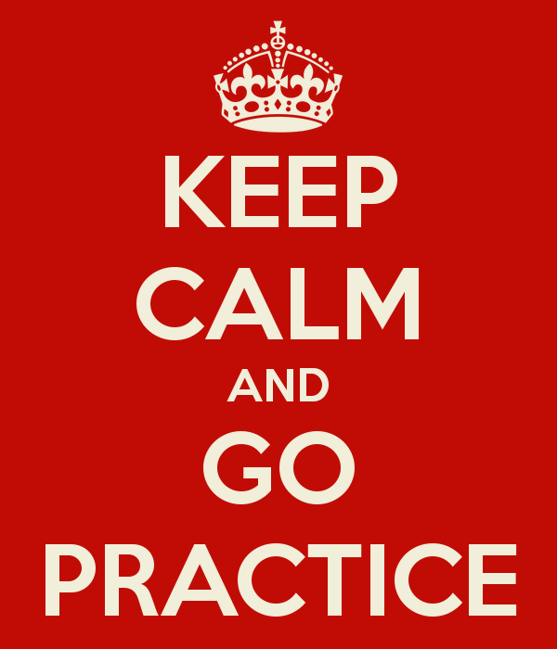
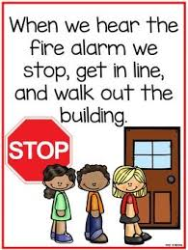
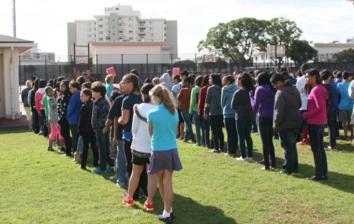
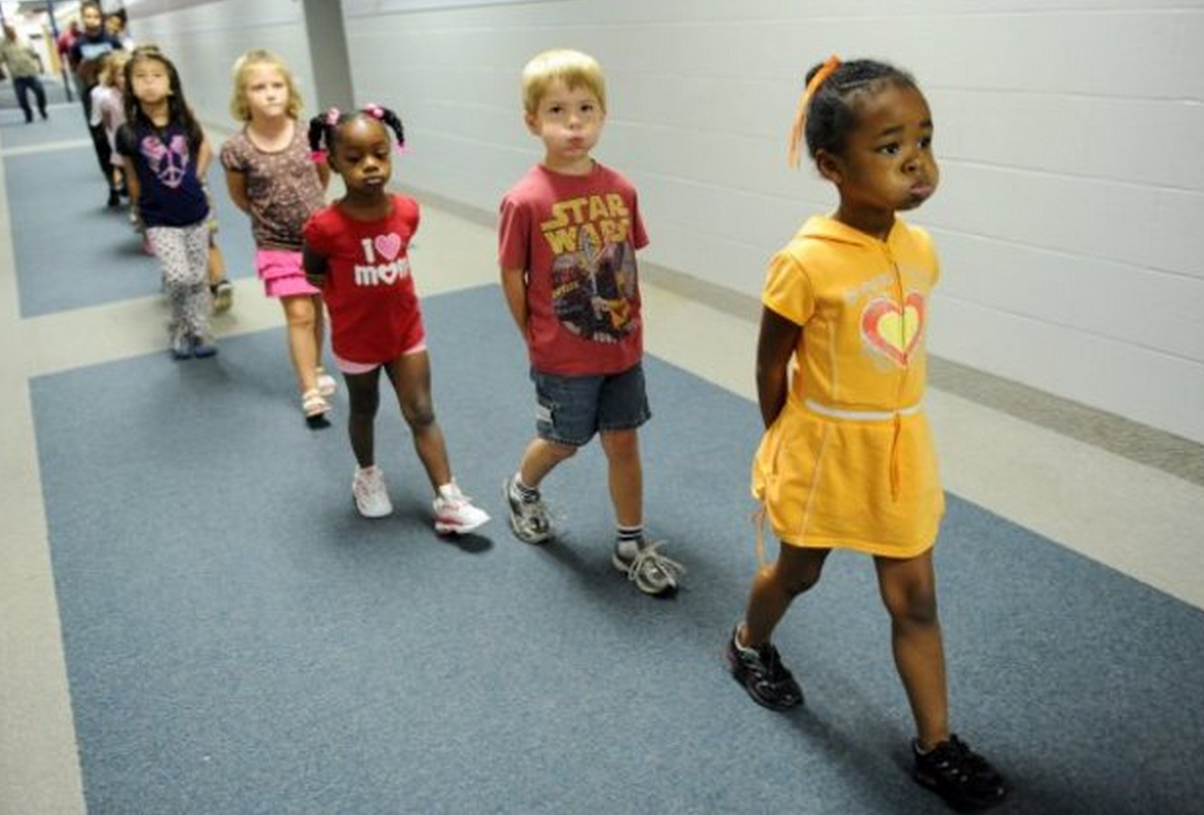
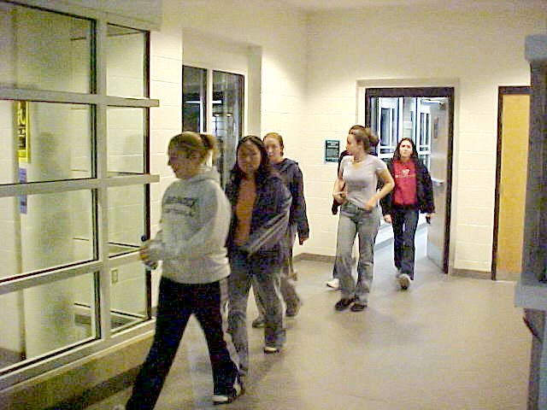
Recap Discussion
Tell us what, "Respectful, Responsible, and Safe... in the media center during a fire drill.
Looks Feels Sounds

Slide 10
Demonstrate Gator Character
We are Respectful, We are Responsible, We are Safe.
In the Media Center…

